Slide 1

HOUSING PRICE PREDICTION
Presented by:
Anusha Gillella
Faezeh Sadat Movahhedi
Samira Bourezama

Slide 2
METHODS and TOOLS
Tools
MySQL
Tableau
python
Models:
Linear Regression model
Random Forest Regressor

Slide 3
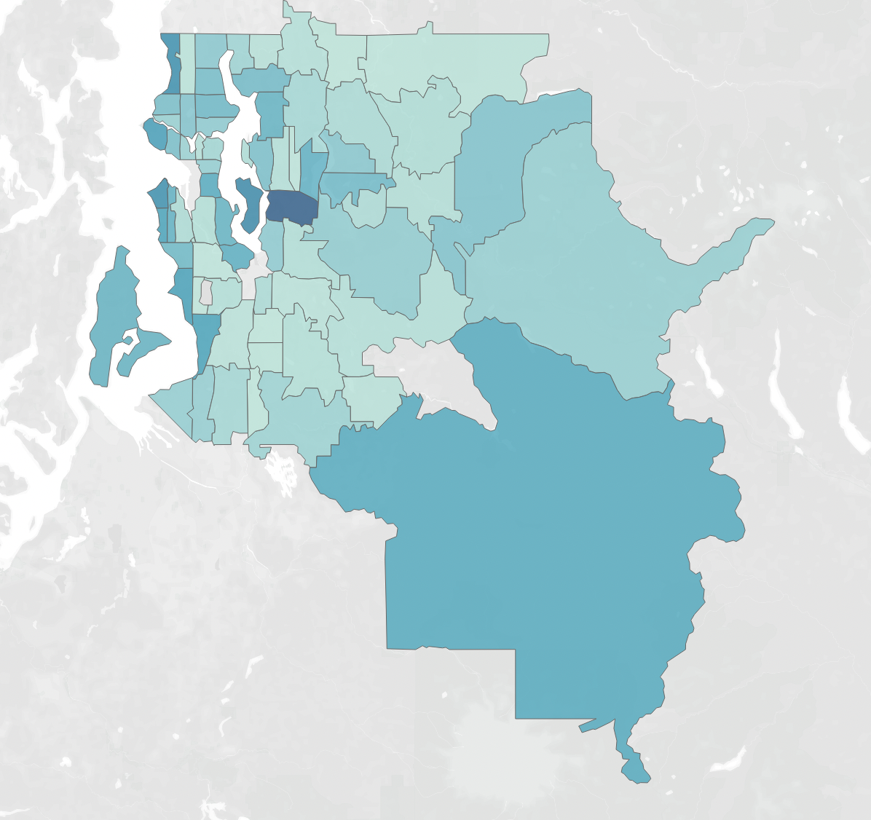
PROJECT SPECIFICATION
The goal of this project is house price prediction in Washington based on features such as area, number of bedrooms, bathrooms, condition, grade etc.
Linear Regression algorithm is used to train and test the model in our project.
To know the accuracy of the model, i.e. how well these features can predict house prices.

Slide 4
Problem Statement
Which locations within the washington neighbourhood areas have the highest average house prices?
Does time of the year have an impact on house sales?
Which house attributes increase sale price?

Slide 5
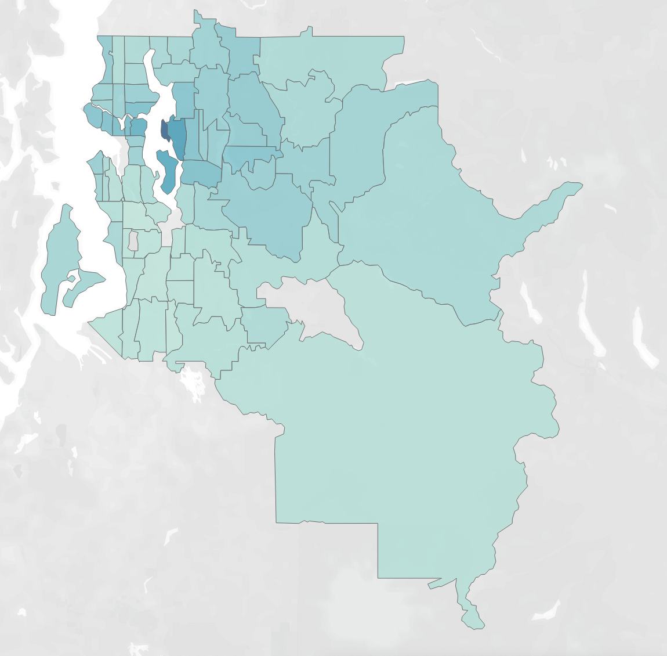
Price distribution based on Zip codes
Medina(98039), Clyde Hill(98004) and Mercer Island(98040) are the most expensive neighbourhoods located on the waterfront.
(Dark Blue = Highest average price, Light Blue = Lowest average price)

Slide 6
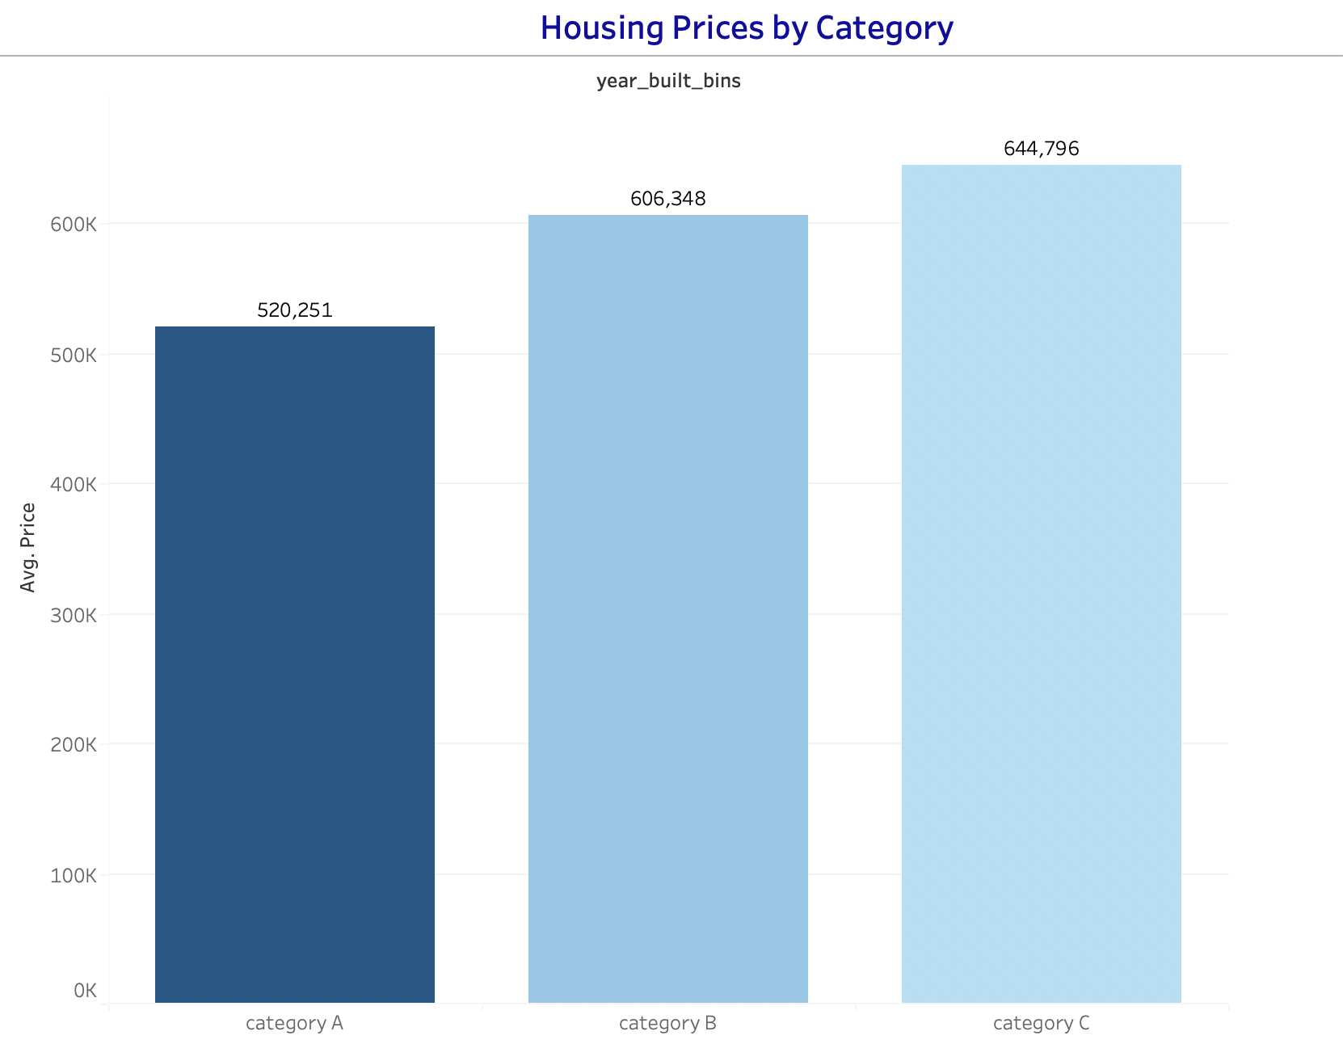
Housing price by Category
Category A: 1900-2000
Category B: 2000-2010
Category C: After 2010
Highest average price houses built in after 2010
Most number of houses built in between 1900-2000
Note:
Average sales indicates the Height
Total sales indicates the Color (Dark Blue = Highest sales, Light Blue = Lowest sales)

Slide 7
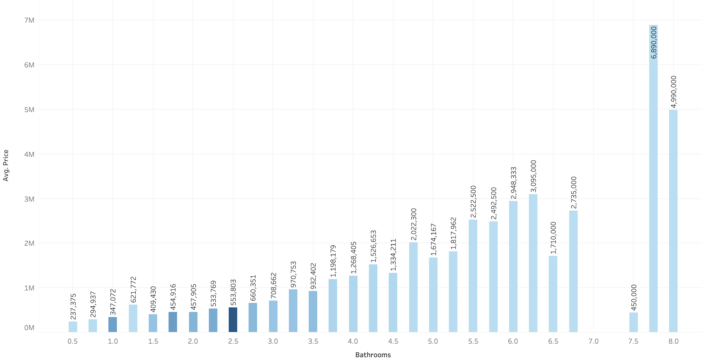
Distribution of bathrooms vs price
Houses with 7.75sqft Bathroom have Highest average price.
Most of the sales have 2.5sqft bathrooms.
Note:
Average sales indicates the Height
Total sales indicates the Color (Dark Blue = Highest sales, Light Blue = Lowest sales)

Slide 8
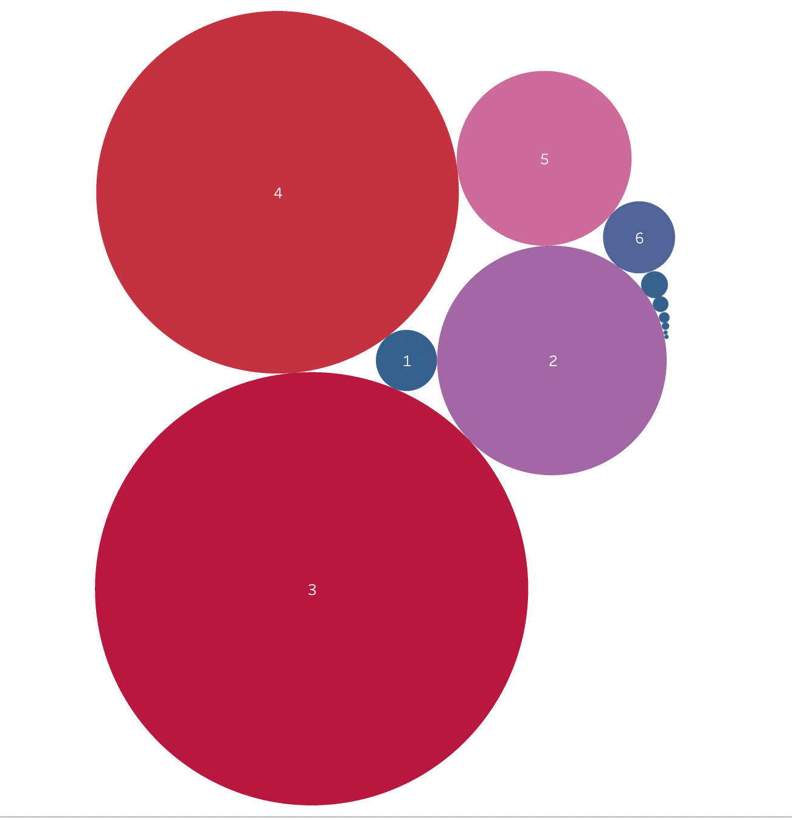
Number of properties based on bedrooms
Most number of people prefer a 3- or 4-Bedroom houses.

Slide 9
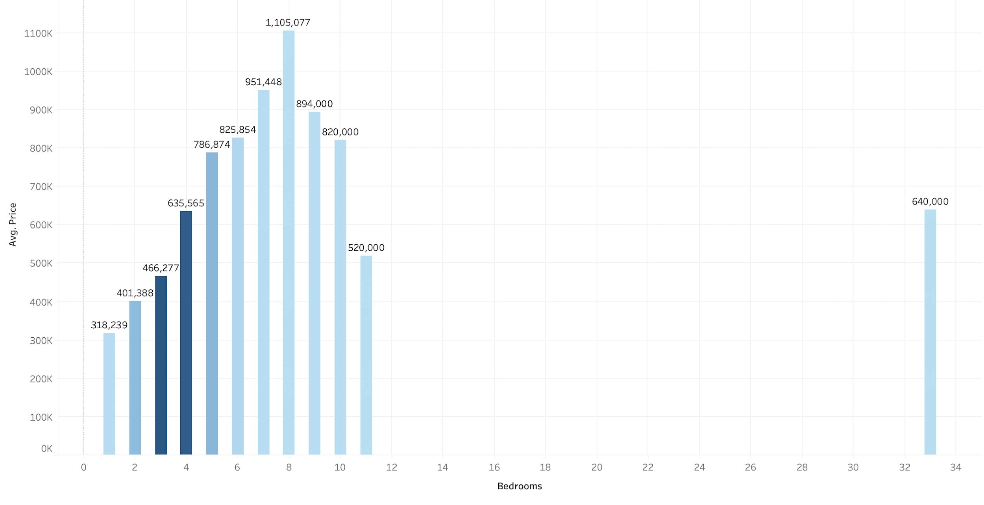
Distribution of bedrooms vs price
8 Bedroom houses have highest average price.
Most of the sales have 3 or 4 Bedrooms.
Note:
Average sales indicates the Height
Total sales indicates the Color (Dark Blue = Highest sales, Light Blue = Lowest sales)

Slide 10
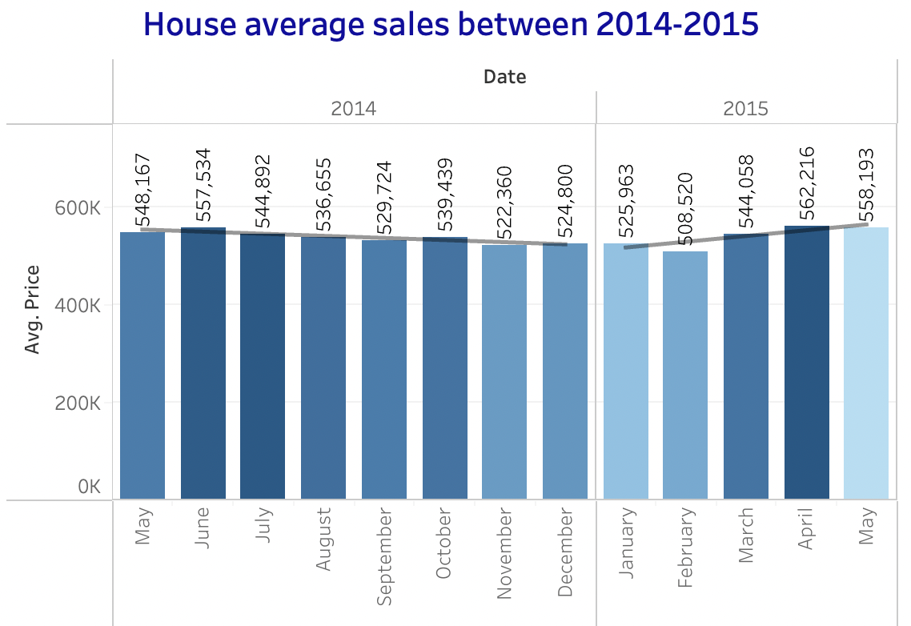
Average House Sales
In May of 2015 avg price is more than May 2014.
Best time to sell a house : April, May and June
Best time to buy a house : February
Note:
Average sales indicates the Height
Total sales indicates the Color (Dark Blue = Highest sales, Light Blue = Lowest sales)

Slide 11
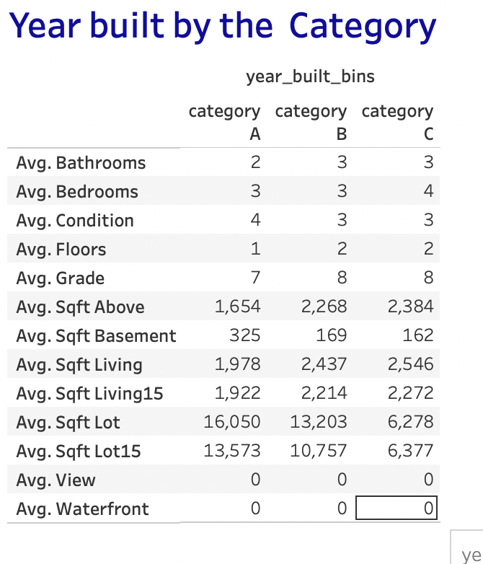
Features of popular houses

Slide 12
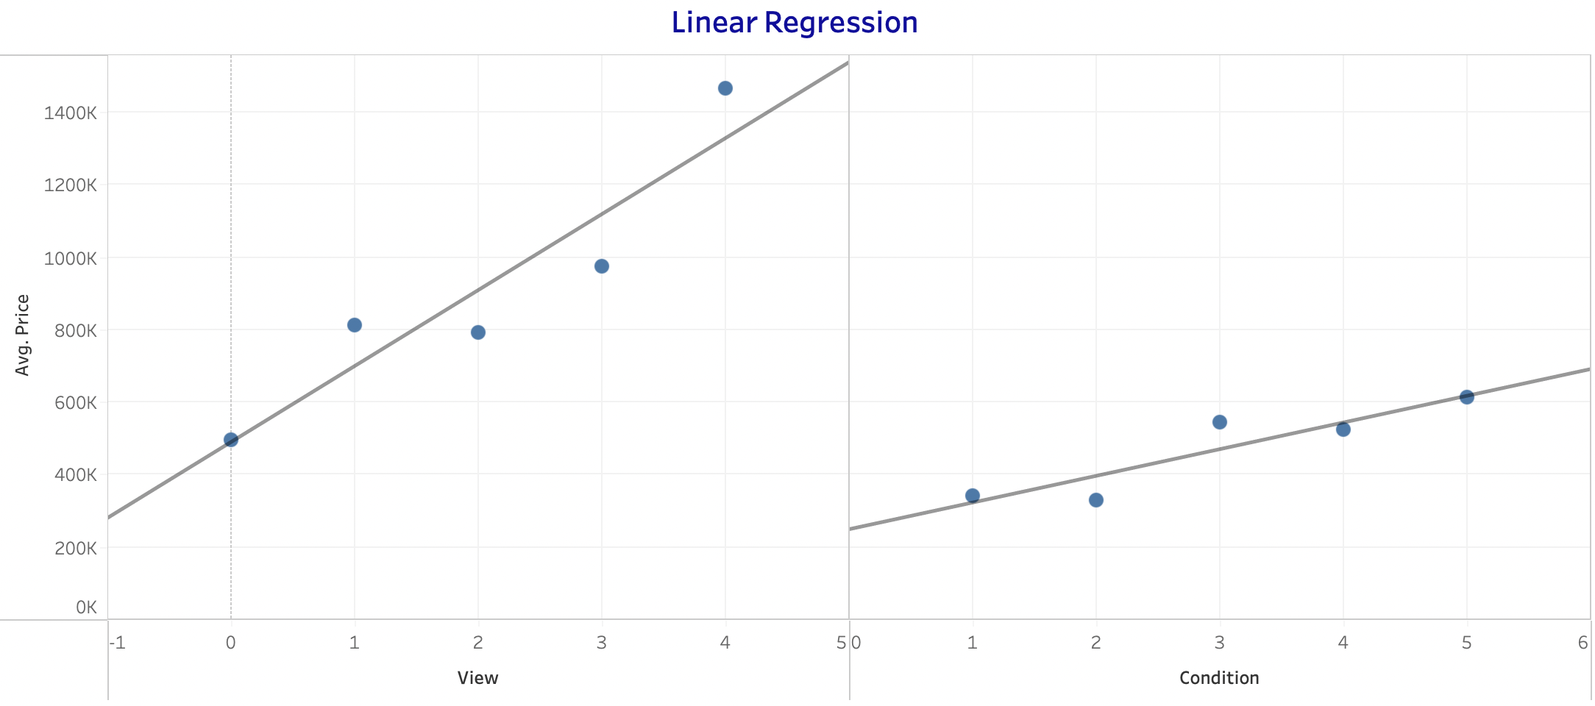
Tableau Linear Regression plot
The Linear Regression plot average of Price vs Features r2 score:
Bathrooms : 0.597
Bedrooms : 0.025
Condition : 0.835
Floors : 0.411
Grade : 0.729
Sqft Above : 0.599
Sqft Basement : 0.457
Sqft Living : 0.676
Sqft Living15 : 0.622
Sqft Lot : 0.009
Sqft Lot15 : 0.008
View : 0.869
Waterfront : 1

Slide 13
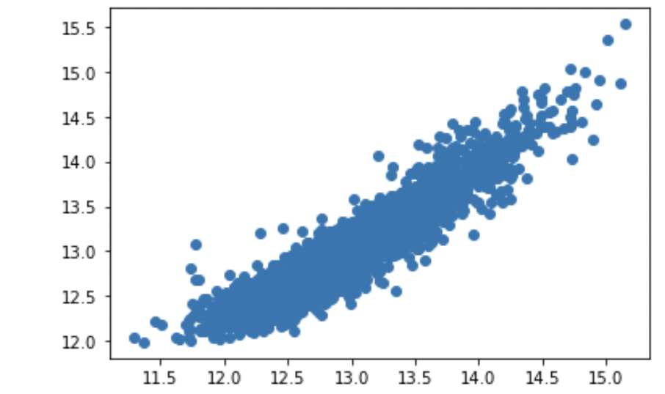
Linear Regression model by Anusha
Scaling Techniques: Standard Scaler
Models :
. Linear Regression
. Random Forest Regressor
r2 score: 0.88
RMSE = 0.18

Slide 14
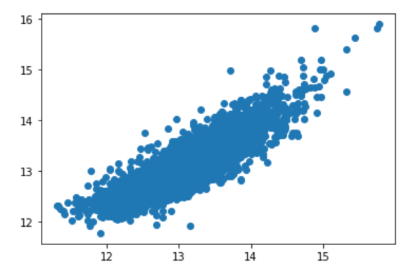
Linear Regression model by Faezeh
Scaling Techniques: Normalizer
Model :
. Linear Regression => r2 score = 0.76
RMSE = 0.25
. Random Forest Regressor => r2 score = 0.87
RMSE = 0.25

Slide 15
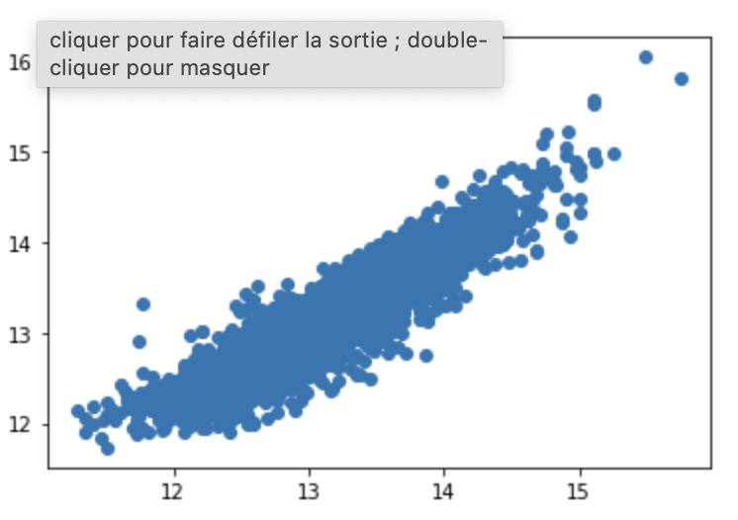
Linear Regression model by Samira
Scaling Technique : Log Transformation
Model : Linear Regression
r2 score : 0.84
RMSE : 0.20

Slide 16

Thanks for your attention!

